Slide 1

INTRODUCTION TO Machine Learning 3rd Edition
Lecture Slides for
ETHEM ALPAYDIN
© The MIT Press, 2014
alpaydin@boun.edu.tr
http://www.cmpe.boun.edu.tr/~ethem/i2ml3e

Slide 2
UNIT II FEATURE ENGINEERING AND DIMENSIONALITY REDUCTION
Feature Engineering – Feature Transformation – Feature Subset Selection - Principle Component Analysis – Feature Embedding – Factor Analysis – Singular value decomposition and Matrix Factorization – Multidimensional scaling – Linear Discriminant Analysis – Canonical Correlation Analysis – Isomap – Locally linear Embedding – Laplacian Eigenmaps.

Slide 3
CHAPTER 6: Dimensionality Reduction

Slide 4
Why Reduce Dimensionality?
Reduces time complexity: Less computation
Reduces space complexity: Fewer parameters
Saves the cost of observing the feature
Simpler models are more robust on small datasets
More interpretable; simpler explanation
Data visualization (structure, groups, outliers, etc) if plotted in 2 or 3 dimensions

Slide 5
Feature Selection vs Extraction
Feature selection: Choosing k<d important features, ignoring the remaining d – k
Subset selection algorithms
Feature extraction: Project the
original x_{i} , i =1,...,d dimensions to
new k<d dimensions, z_{j} , j =1,...,k

Slide 6
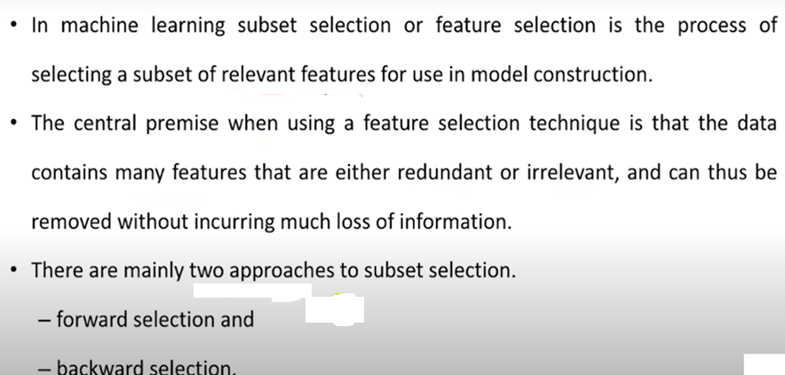

Slide 7
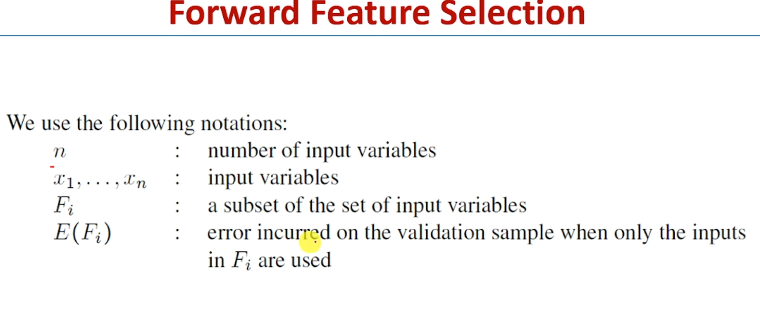

Slide 8
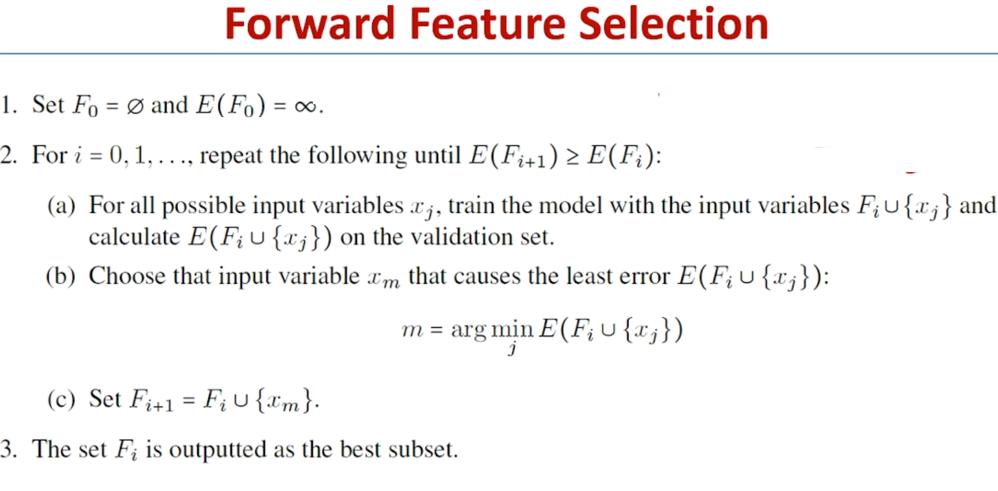

Slide 9
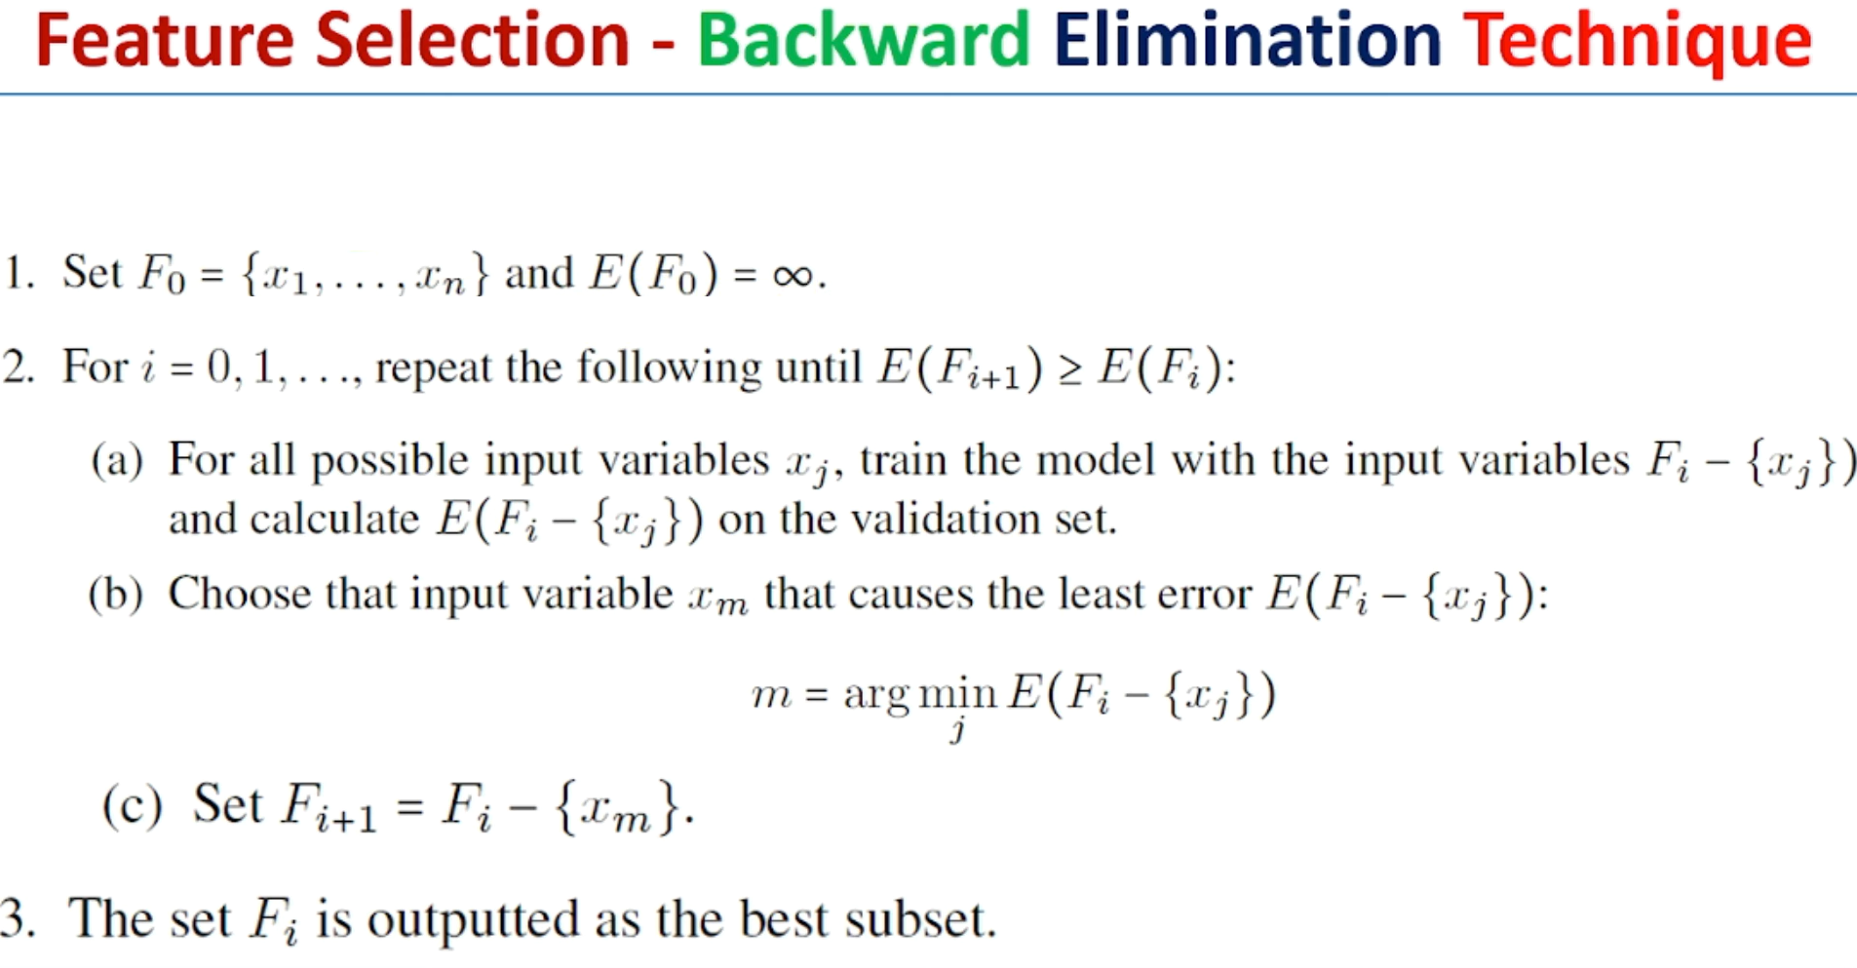

Slide 10
Subset Selection
There are 2^{d} subsets of d features
Forward search: Add the best feature at each step
Set of features F initially Ø.
At each iteration, find the best new feature
j = argmin_{i} E ( F ∪ x_{i} )
Add x_{j} to F if E ( F ∪ x_{j} ) < E ( F )
Hill-climbing O(d²) algorithm
Backward search: Start with all features and remove one at a time, if possible.
Floating search (Add k, remove l)

Slide 11
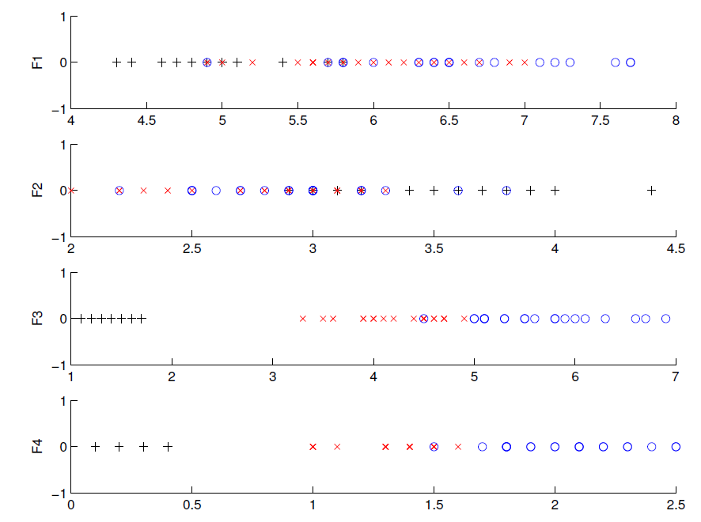
Iris data: Single feature
Chosen

Slide 12
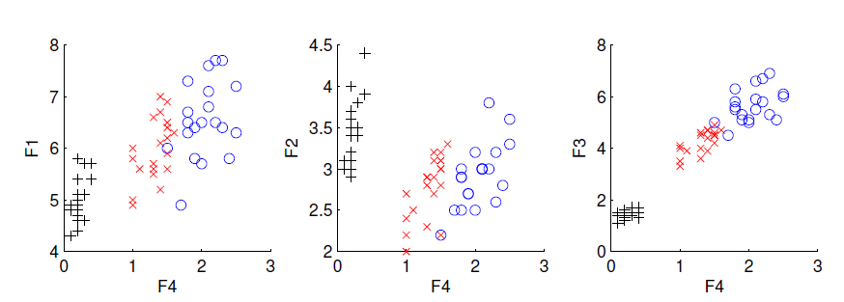
Iris data: Add one more feature to F4
Chosen

Slide 13
Principal Component Analysis(PCA)
As the number of features or dimensions in a dataset increases, the amount of data required to obtain a statistically significant result increases exponentially.
This can lead to issues such as overfitting, increased computation time, and reduced accuracy of machine learning models this is known as the curse of dimensionality problems that arise while working with high-dimensional data.
To address the curse of dimensionality, Feature engineering techniques are used which include feature selection and feature extraction. Dimensionality reduction is a type of feature extraction technique that aims to reduce the number of input features while retaining as much of the original information as possible.
To address the original information as possible.

Slide 14
Principal Component Analysis (PCA) is a statistical procedure that uses an orthogonal transformation that converts a set of correlated variables to a set of uncorrelated variables. PCA is the most widely used tool in exploratory data analysis and in machine learning for predictive models. Moreover,
Principal Component Analysis (PCA) is an unsupervised learning algorithm technique used to examine the interrelations among a set of variables. It is also known as a general factor analysis where regression determines a line of best fit.
The main goal of Principal Component Analysis (PCA) is to reduce the dimensionality of a dataset while preserving the most important patterns or relationships between the variables without any prior knowledge of the target variables.

Slide 15
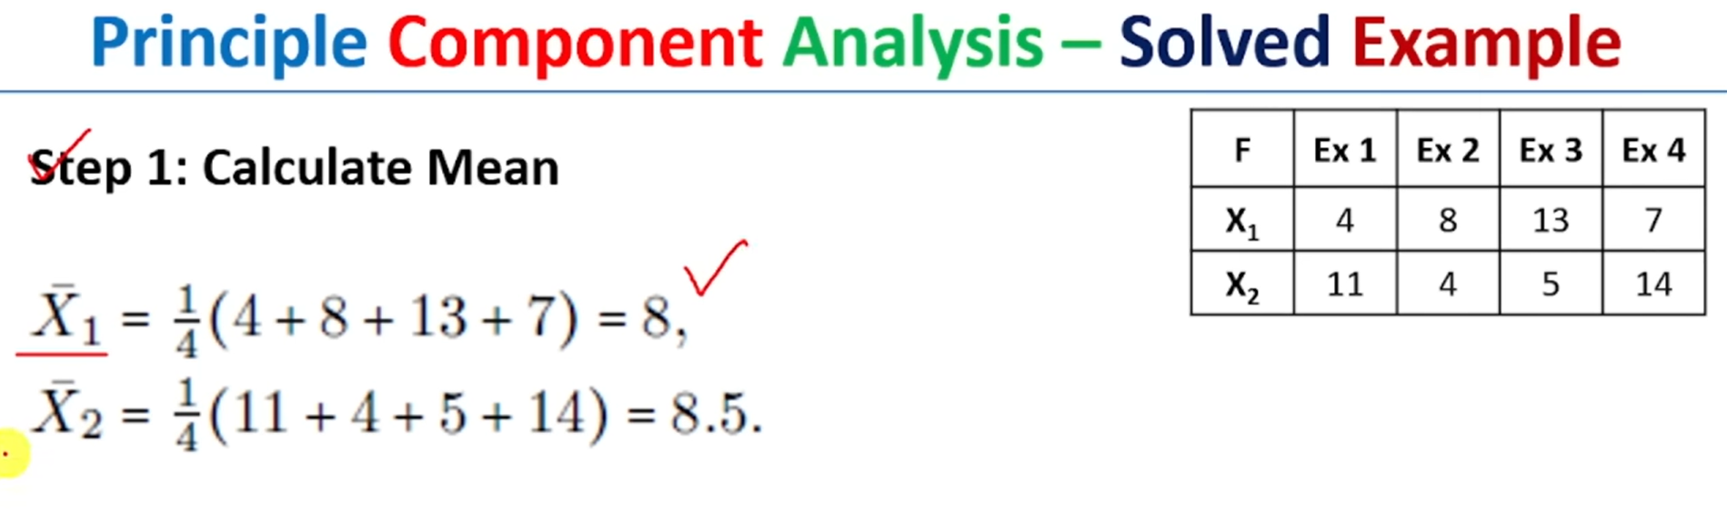

Slide 16
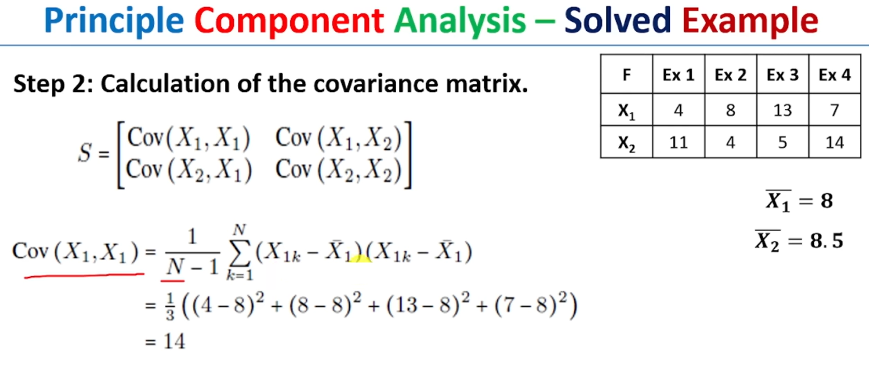

Slide 17
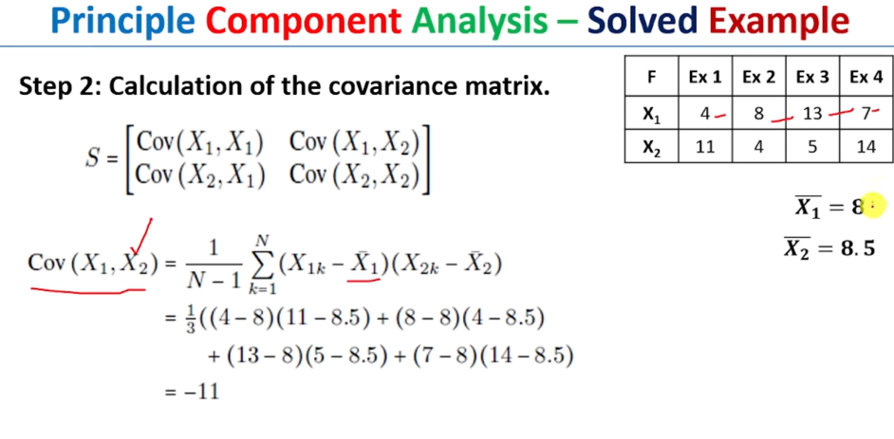

Slide 18
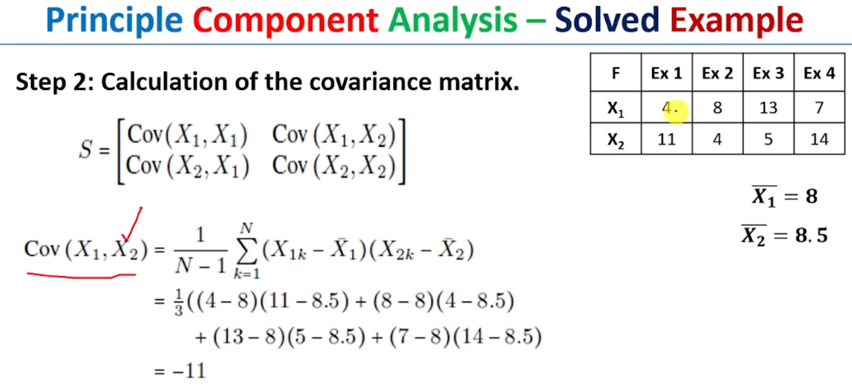

Slide 19
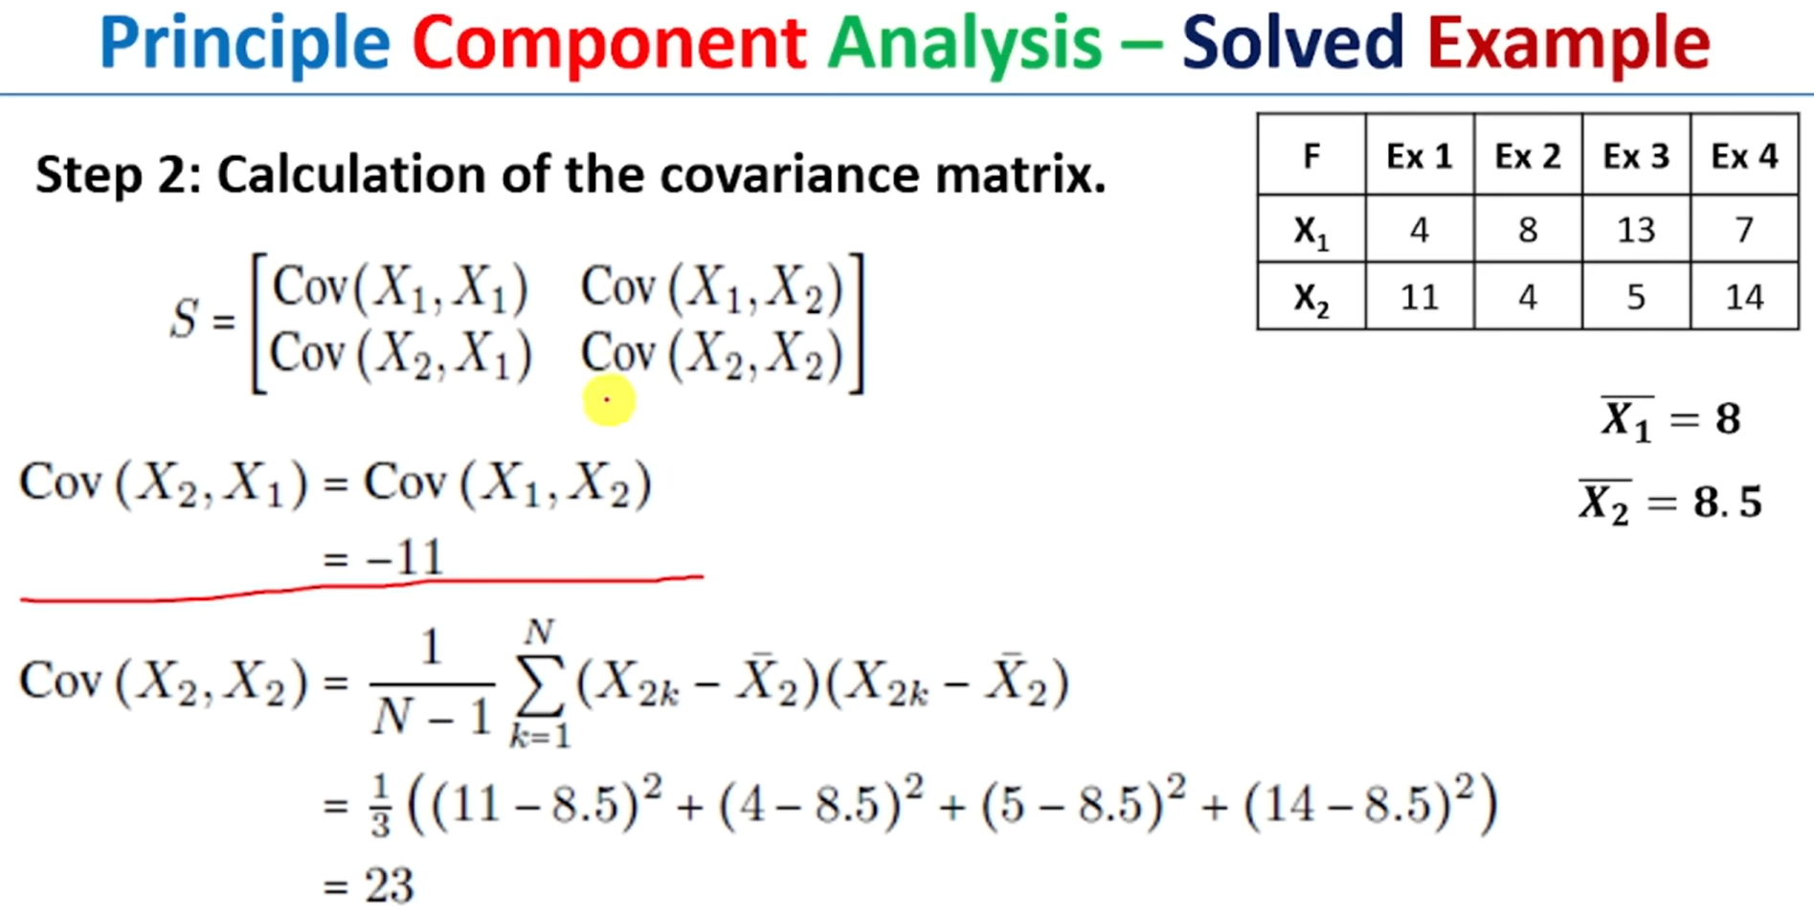

Slide 20
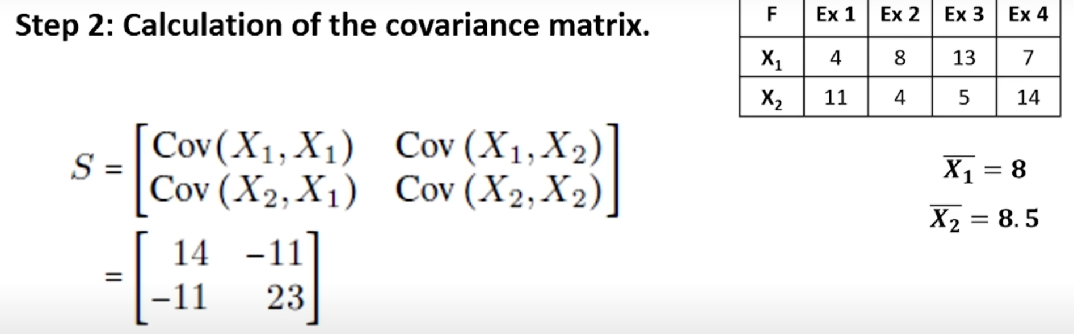

Slide 21
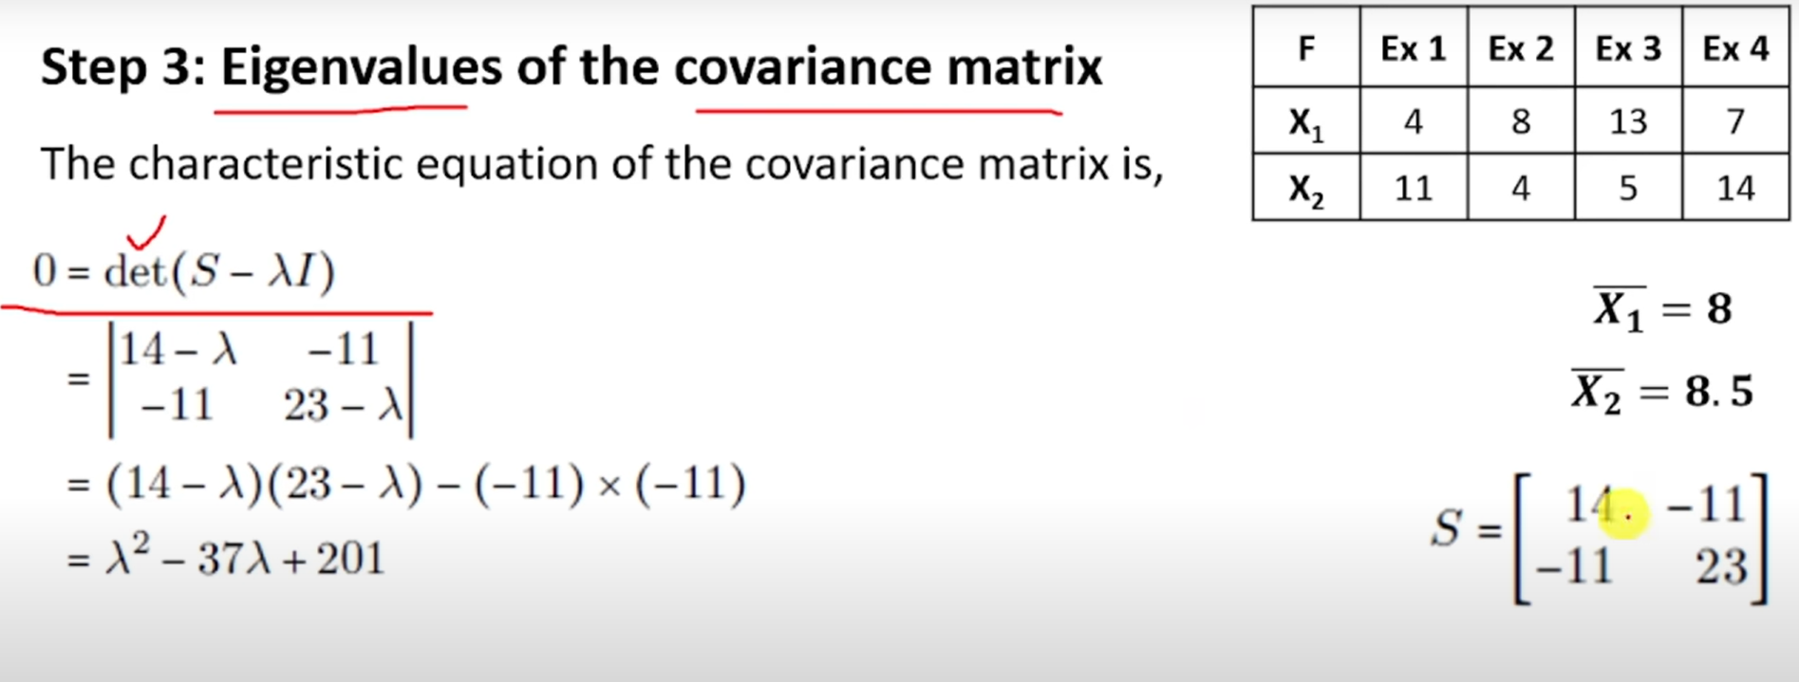

Slide 22
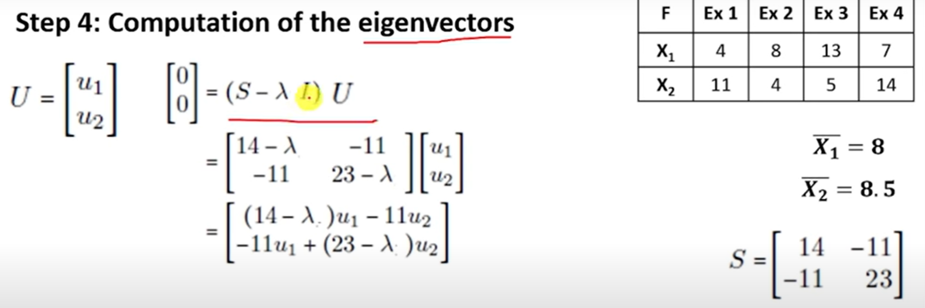
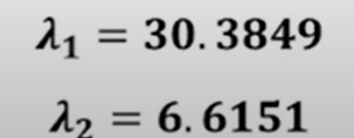

Slide 23
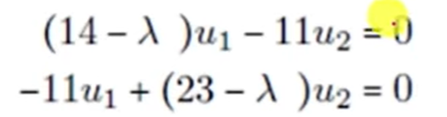

Slide 24
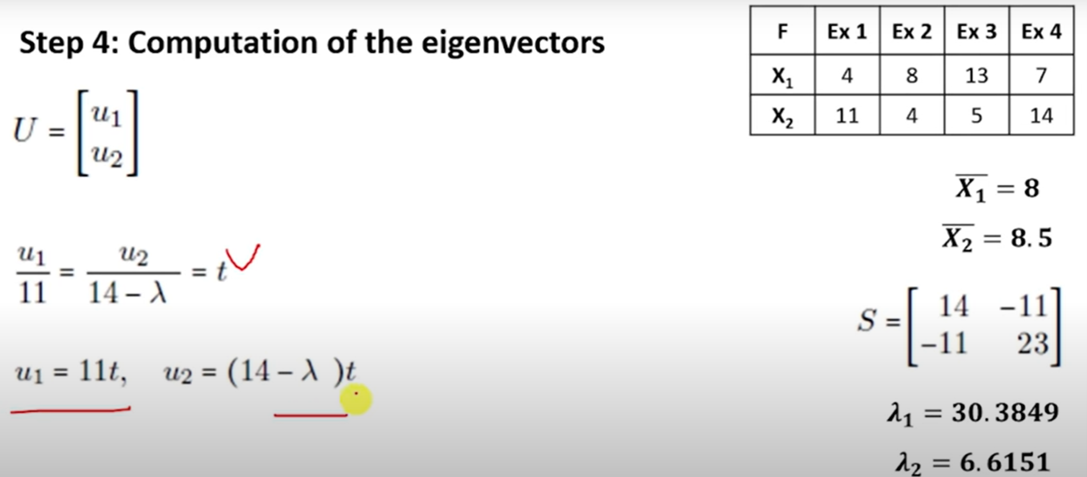

Slide 25
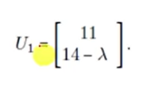

Slide 26
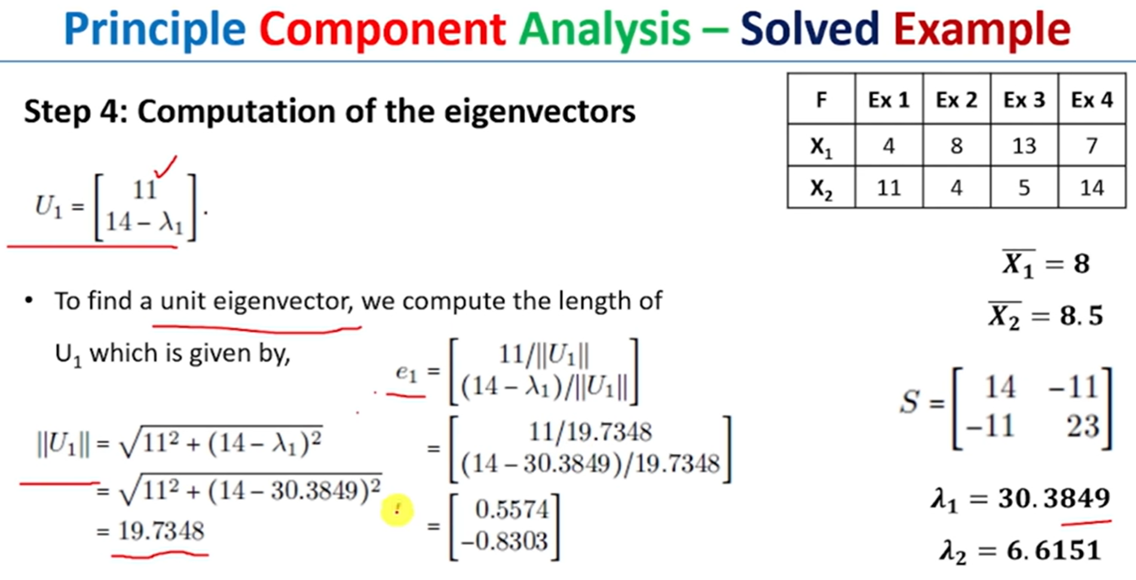

Slide 27
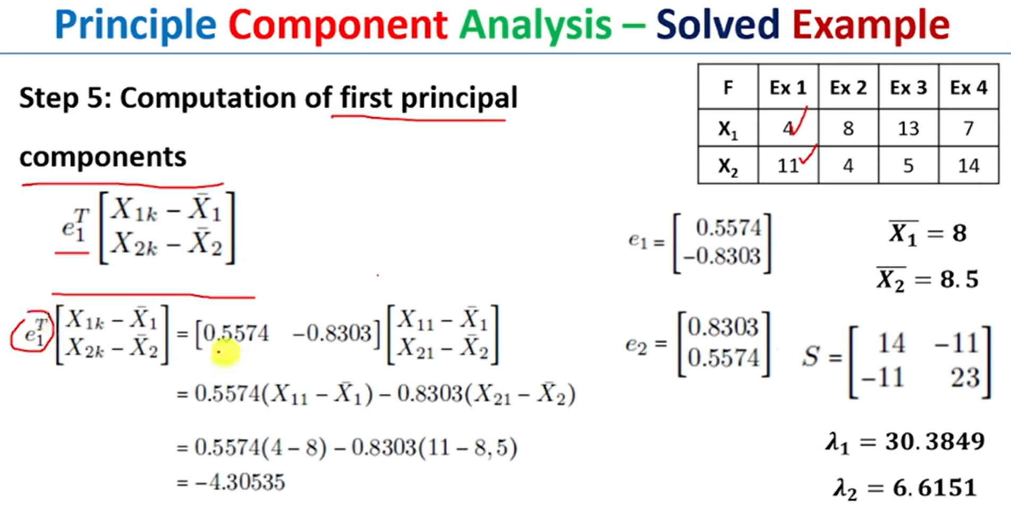

Slide 28
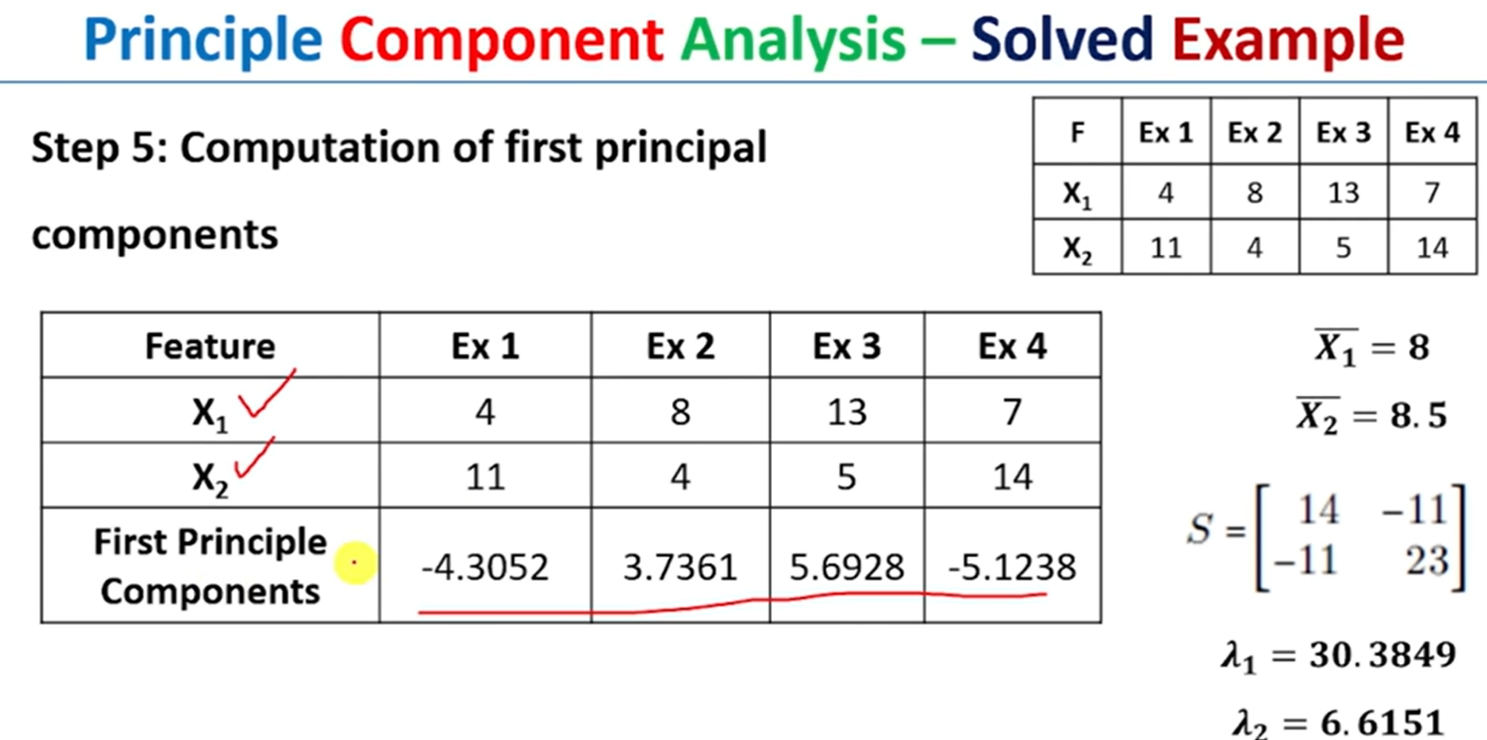

Slide 29
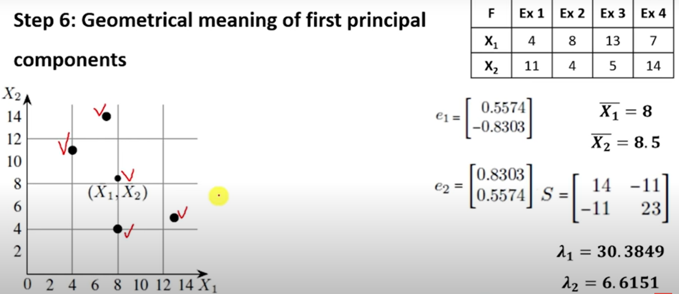

Slide 30
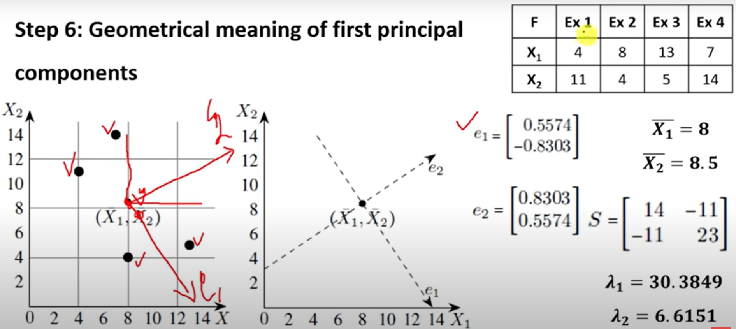

Slide 31
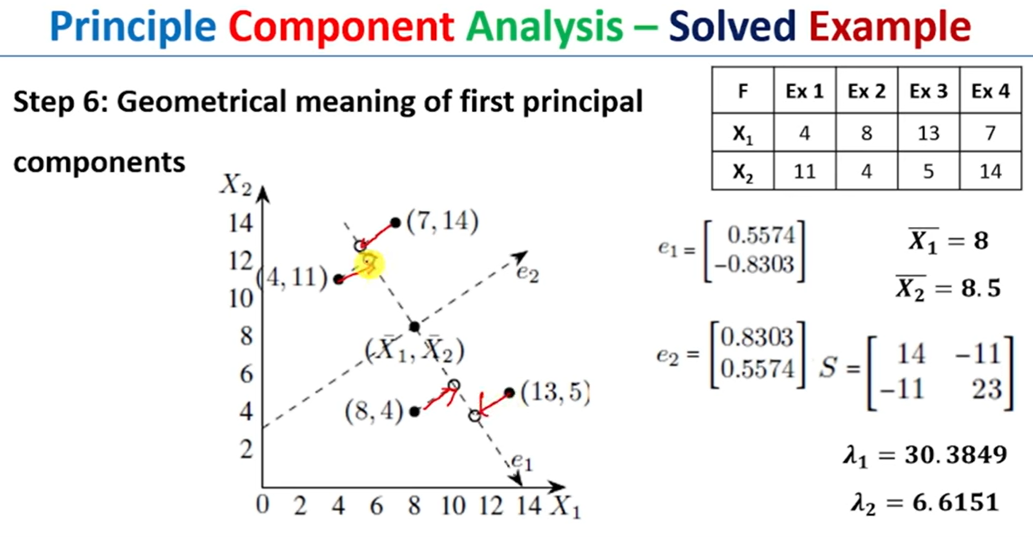

Slide 32
Principal Components Analysis
Find a low-dimensional space such that when x is projected there, information loss is minimized.
The projection of x on the direction of w is: z = w^{T}x
Find w such that Var(z) is maximized
Var(z) = Var(w^{T}x) = E[(w^{T}x – w^{T}μ)²]
= E[(w^{T}x – w^{T}μ)(w^{T}x – w^{T}μ)]
= E[w^{T}(x – μ)(x – μ)^{T}w]
= w^{T} E[(x – μ)(x –μ)^{T}]w = w^{T} ∑ w
where Var(x)= E[(x – μ)(x –μ)^{T}] = ∑

Slide 33
Maximize Var(z) subject to ||w||=1
∑w₁ = αw₁ that is, w₁ is an eigenvector of ∑
Choose the one with the largest eigenvalue for Var(z) to be max
Second principal component: Max Var(z₂), s.t., ||w₂||=1 and orthogonal to w₁
∑ w₂ = α w₂ that is, w₂ is another eigenvector of ∑
and so on.

Slide 34
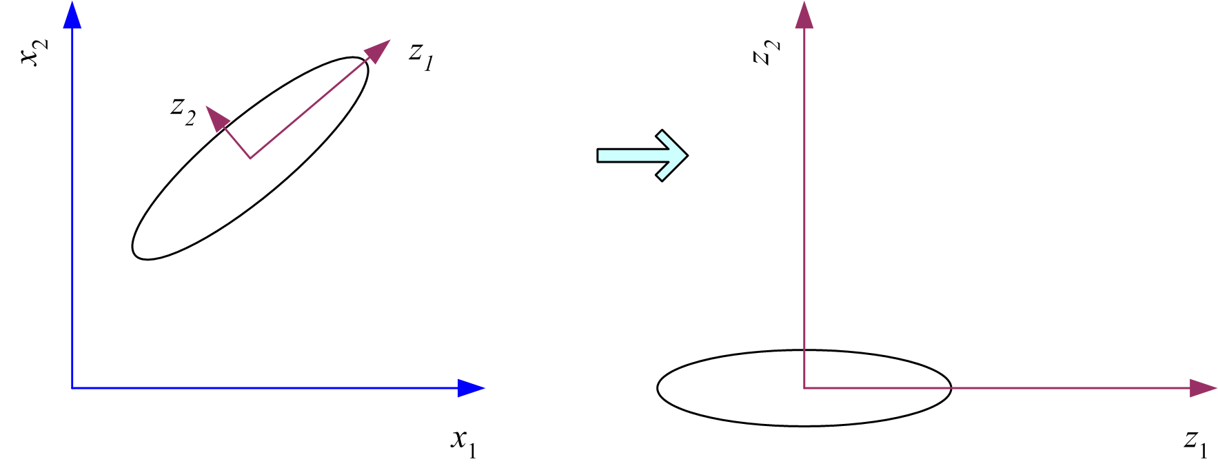
What PCA does
z = W^{T}(x – m)
where the columns of W are the eigenvectors of ∑ and m is sample mean
Centers the data at the origin and rotates the axes

Slide 35
If we form a (d × d) matrix C whose ith column is the normalized eigenvector ci of S, then C^{T}C = I and S = SCC^{T} = S(c1, c2,..., cd)C^{T} = (Sc1, Sc2,..., Scd)C^{T} = (λ1c1, λ2c2,...,λdcd)C^{T} = λ1c1c^{T} 1 +···+ λdcdc^{T} d = CDC^{T}
where D is a diagonal matrix whose diagonal elements are the eigenval spectral ues, λ1,...,λd. This is called the spectral decomposition of S. Since C is decomposition orthogonal and CCT = CT C = I, we can multiply on the left by CT and on the right by C to obtain

Slide 36
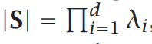
C^{T}SC = D
We know that if z = W^{T}x, then Cov(z) = W^{T}SW, which we would like to be equal to a diagonal matrix. we see that we can set W = C.
In practice even if all eigenvalues are greater than 0, if |S| is small, remembering that
we understand that some eigenvalues have little contribution to variance and may be discarded.
Then, we take into account the leading k components that explain more than, for example, 90 percent, of the variance. When λi are sorted in descending order, the proportion of variance explained by the k principal components is

Slide 37
How to choose k ?
Proportion of Variance (PoV) explained
when λ_{i} are sorted in descending order
Typically, stop at PoV>0.9
Scree graph plots of PoV vs k, stop at “elbow”

Slide 38
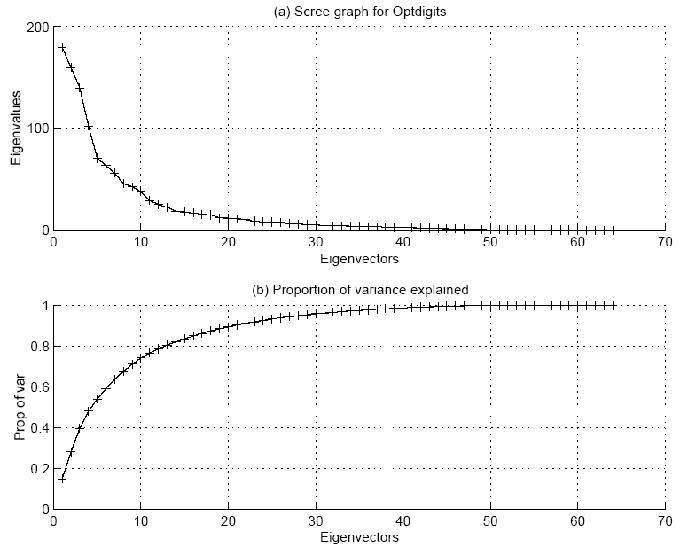

Slide 39
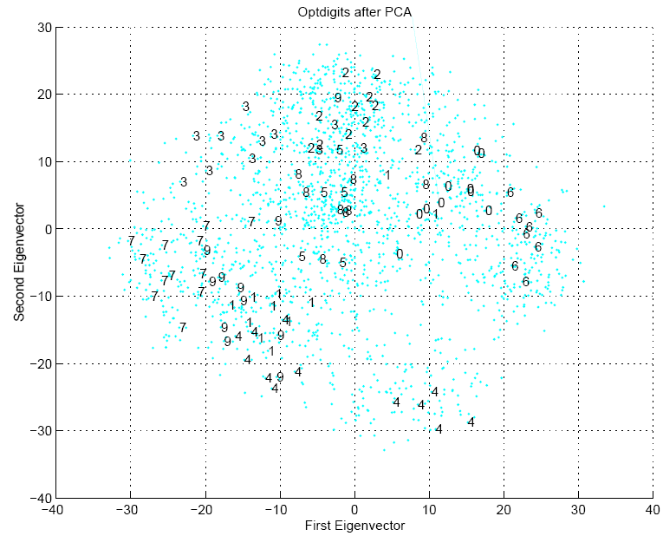

Slide 40
Feature Embedding
When X is the Nxd data matrix,
X^{T}X is the dxd matrix (covariance of features, if mean-centered)
XX^{T} is the NxN matrix (pairwise similarities of instances)
PCA uses the eigenvectors of X^{T}X which are d-dim and can be used for projection
Feature embedding uses the eigenvectors of XX^{T} which are N-dim and which give directly the coordinates after projection Sometimes, we can define pairwise similarities (or distances) between instances, then we can use feature embedding without needing to represent instances as vectors.

Slide 41
Feature Embedding
Remember that X is the N × d data matrix where N is the number of instances and d is the input dimensionais d × d and is equal to X^{T}X if X is centered to have zero mean (without loss of generality). Principal component analysis uses the eigenvectors of X^{T}X. Remember that the spectral de compositionislity.
The covariance matrix of x
X^{T} X = WDW^{T}
where W is d × d and contains the eigenvectors of X^{T}X in its columns and D is a d × d diagonal matrix with the corresponding eigenvalues. We assume that the eigenvectors are sorted according to their eigenvalues so that the first column of W is the eigenvector with the largest eigenvalue in D₁₁, and so on. If X^{T} X has rank k<d, then D_{ii}=0 for i>k.

Slide 42
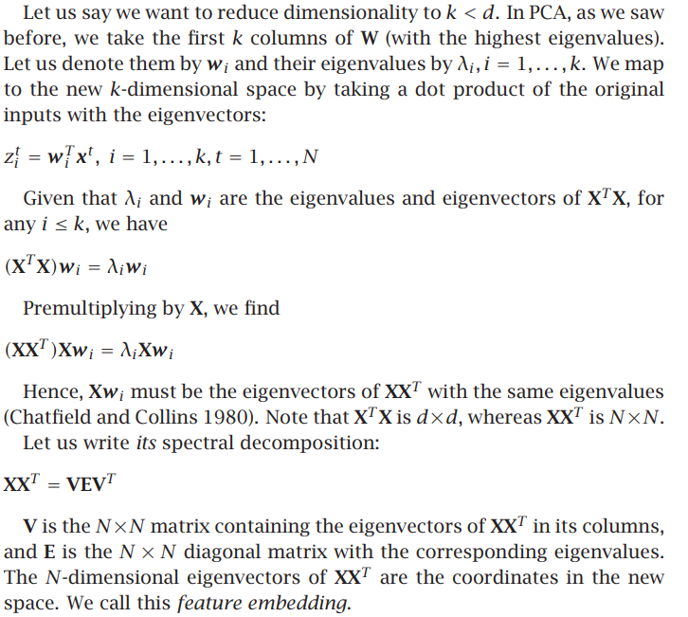

Slide 43
Feature Embedding: Feature embedding aims to represent categorical variables in a lower-dimensional continuous space. Instead of using a one-hot encoding, each category is mapped to a dense vector of continuous values, known as an embedding vector. These embedding vectors are learned during the training process and are adjusted to optimize the model's performance on a specific task.

Slide 44
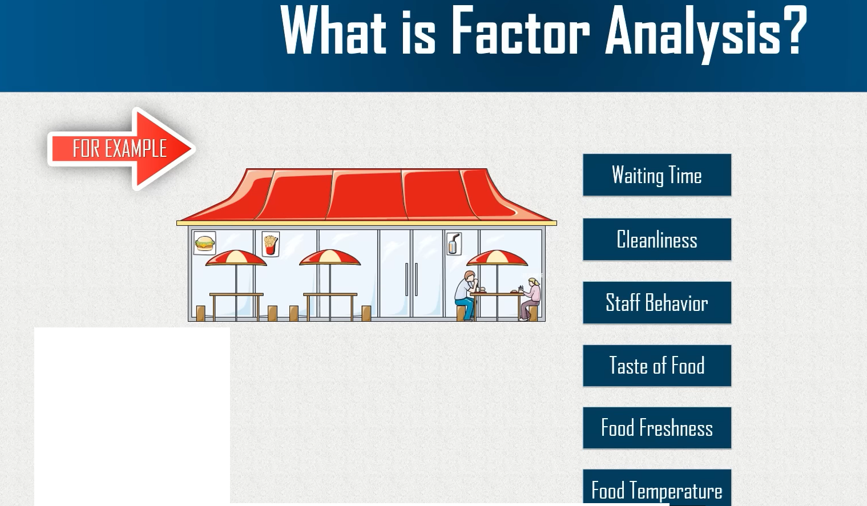
Factor Analysis

Slide 45
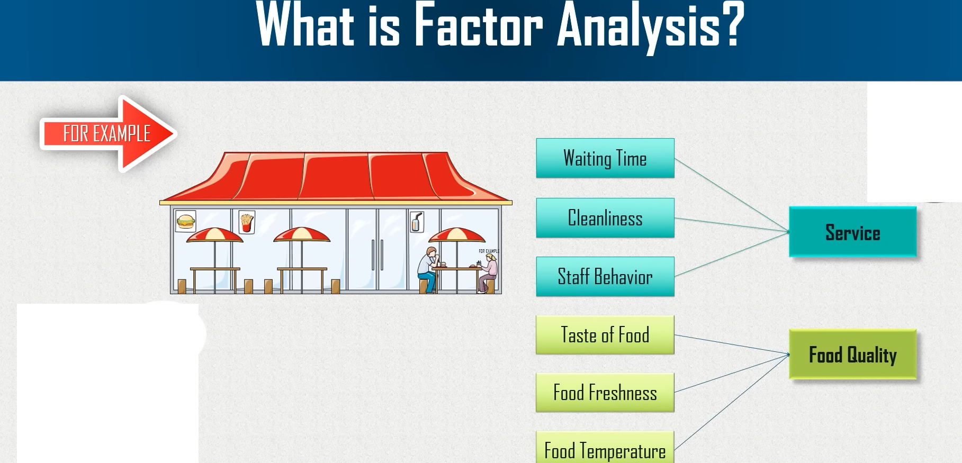

Slide 46
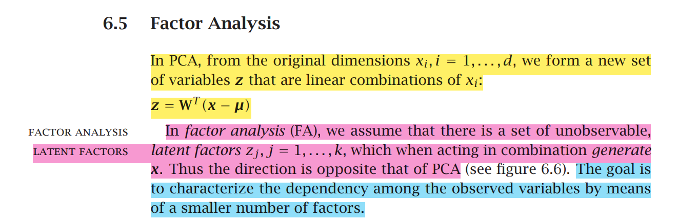

Slide 47
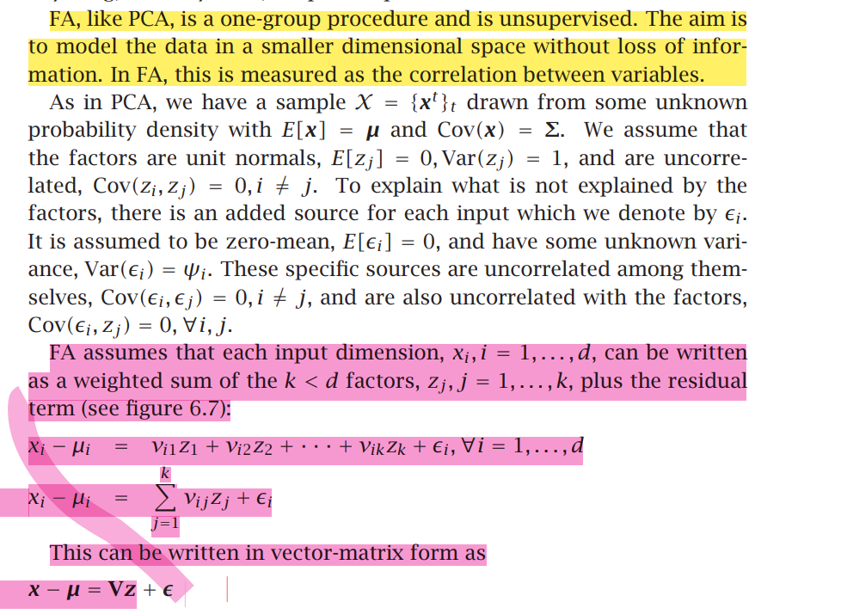

Slide 48
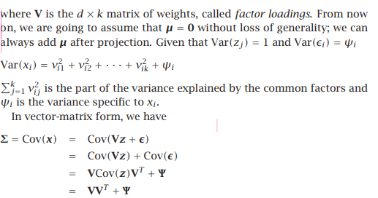
where Ψ is a diagonal matrix with ψi on the diagonals.

Slide 49
Factor Analysis
In PCA, from the original dimensions xi, i = 1,...,d, we form a new set of variables z that are linear combinations of xi:
z = W^{T} (x − μ)
In factor analysis (FA), we assume that there is a set of unobservable, latent factors latent factors zj , j = 1,...,k, which when acting in combination generate x. Thus the direction is opposite that of PCA
The goal is to characterize the dependency among the observed variables by means of a smaller number of factors.

Slide 50
Factor Analysis
Find a small number of factors z, which when combined generate x :
x_{i} – µ_{i} = v_{i1}z₁ + v_{i2}z₂ + ... + v_{ik}z_{k} + ε_{i}
where z_{j}, j =1,...,k are the latent factors with
E[ z_{j} ]=0, Var(z_{j})=1, Cov(z_{i ,}, z_{j})=0, i ≠ j ,
ε_{i} are the noise sources
E[ ε_{i} ]= ψ_{i}, Cov(ε_{i} , ε_{j}) =0, i ≠ j, Cov(ε_{i} , z_{j}) =0 ,
and v_{ij} are the factor loadings

Slide 51
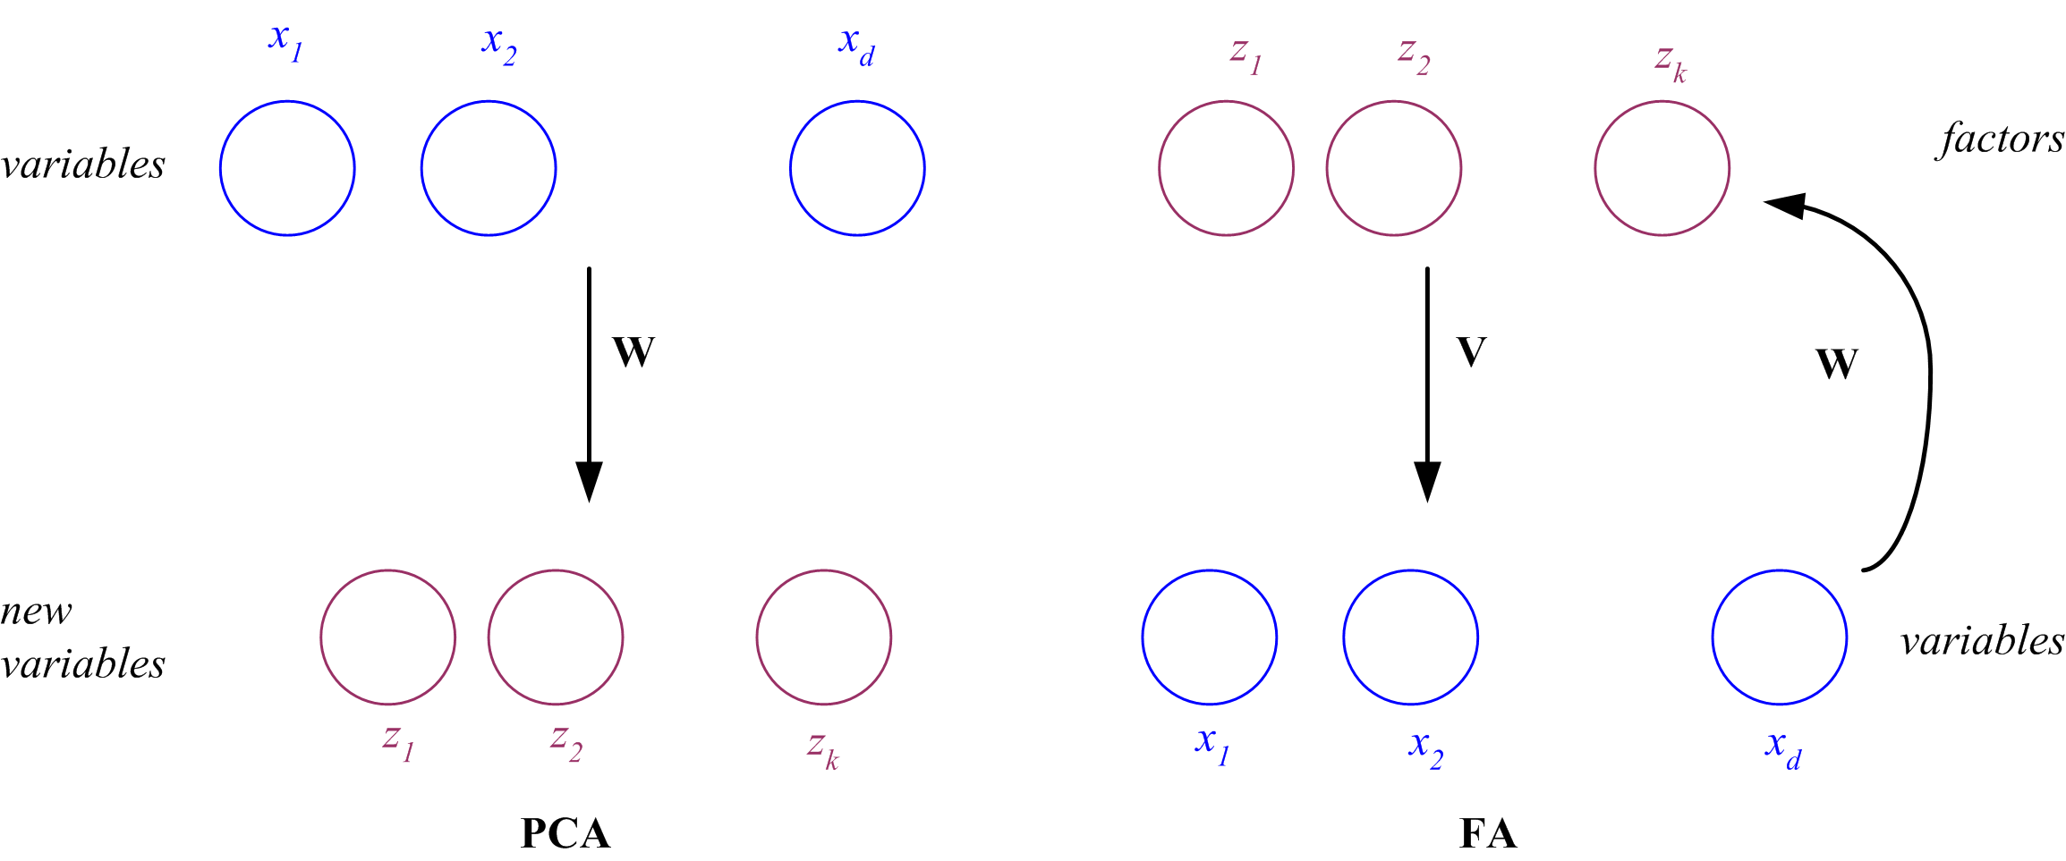
PCA vs FA
PCA From x to z z = W^{T}(x – µ)
FA From z to x x – µ = Vz + ε
x
z
z
x

Slide 52
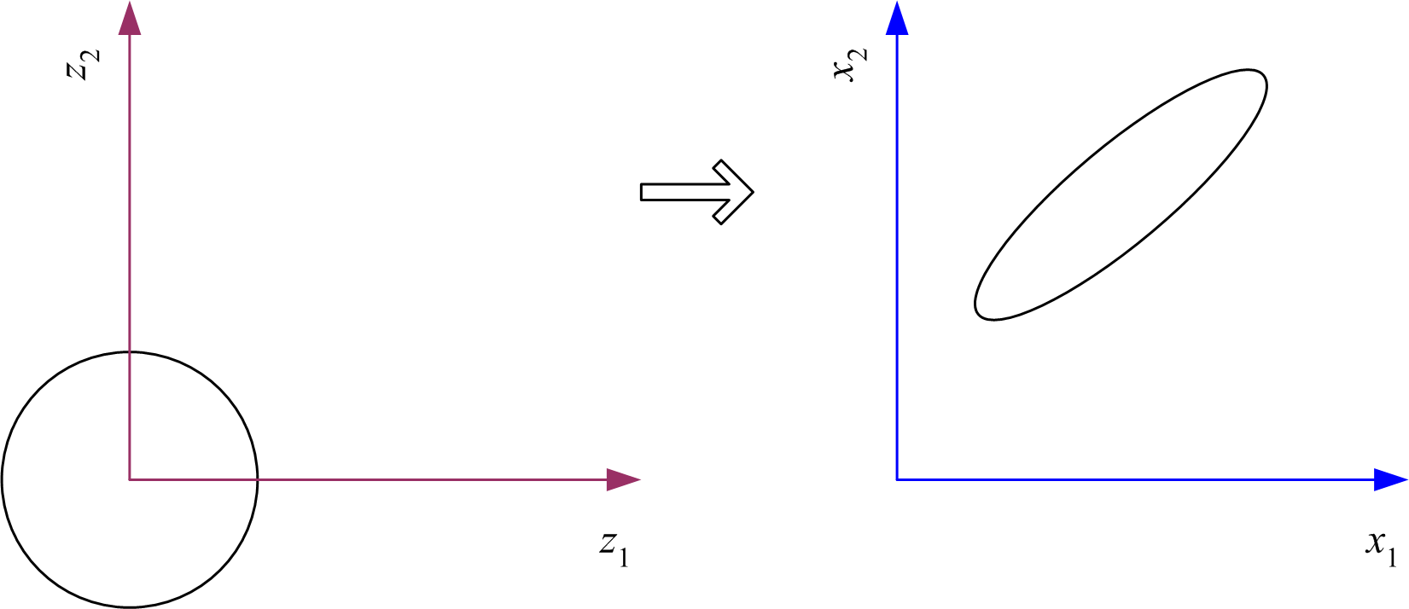
Factor Analysis
In FA, factors z_{j} are stretched, rotated and translated to generate x

Slide 53
m
 | Principal Component Analysis | Factor Analysis
Meaning | A component is a derived new dimension (or variable) so that the derived variables are linearly independent of each other. | A factor (or latent) is a common or underlying element with which several other variables are correlated.
Purpose | PCA is used to decompose the data into a smaller number of components and therefore is a type of Singular Value Decomposition (SVD). | Factor Analysis is used to understand the underlying ‘cause’ which these factors (latent or constituents) capture much of the information of a set of variables in the dataset data. Hence, it is also known as Common Factor Analysis (CFA).
Assumption | PCA looks to identify the dimensions that are composites of the observed predictors. | Factor analysis explicitly presumes that the latent (or factors) exist in the given data.

Slide 54
Objective | The aim of PCA is to explain as much of the cumulative variance in the predictors (or variables) as possible. | FA focuses on explaining the covariances or the correlations between the variables.
How much variation is explained? | The components explain all the variance in the data. PCA captures the maximum variance in the first component, then in the second component, and henceforth followed by the other components. | The latent themselves are not directly measurable, and they do not explain all the variance in the data. Hence, it results in an error term that is unique to each measured variable.
Process | In PCA, the components are calculated as the linear combinations of the original variables. | In factor analysis, the original variables are defined as the linear combinations of the factors.

Slide 55
Mathematical representation | Y = W1* PC1 + W2* PC2+… + W10 * PC10 +C Where, PCs are the components and Wis are the weights for each of the components. | X1 = W1*F + e1 X2 = W2*F + e2 X3 = W3*F + e3 Where, F is the factor, Wis are the weights and eis are the error terms. The error is the variance in each X that is not explained by the factor.
Interpretation of the weights | The weights are the correlation between the standardized scores of the predictors (or variables) and the principal components, also known as the factor loadings. For example, in PCA, the weights indicate which component contributes more to the target variable, Y, as the independent variables are standardized. | The weights in the factor analysis express the relationship or association of each variable (X) to the underlying factor (F). These are also known as the factor loadings and can be interpreted as the standardized regression coefficients.

Slide 56
Estimation of the weights | PCA uses the correlation matrix of the variables, which generates the eigenvectors (or the components) and estimates it as the betas (or the coefficients). | The process of factor analysis ascertains the optimal weights.
Pecking order | In PCA, the variables are specified and then estimate the weights (coefficients or betas) through regression. | In factor analysis, the latent (or the factors) are first specified and then estimate the factor returns through regression.

Slide 57
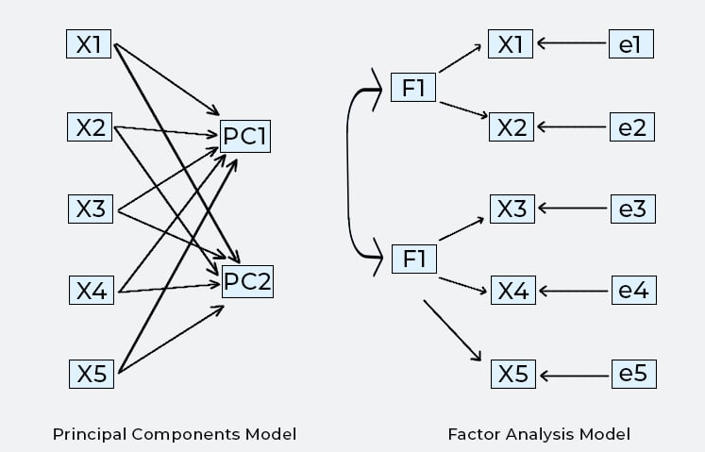

Slide 58
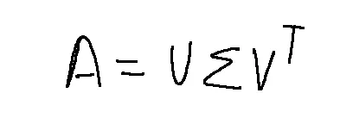
Singular value decomposition and Matrix Factorization
A is the input matrix
U are the left singular vectors,
sigma are the diagonal/eigenvalues
V are the right singular vectors.
The shape of these three matrices will be
A — m x n matrix
U — m x k matrix
Sigma — k x k matrix
V — n x k matrix

Slide 59
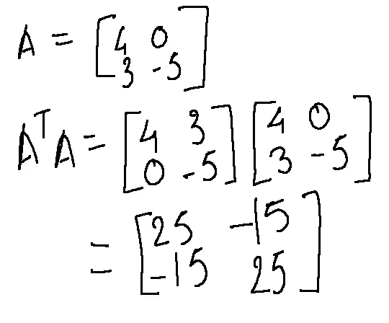
Step 1
So, as the first step, we need to find eigenvalues of matrix A and as A can be a rectangular matrix, we need to convert it to a square matrix by multiplying A with its transpose. Here, for easier computation I have taken A as a 2 x 2 matrix.

Slide 60
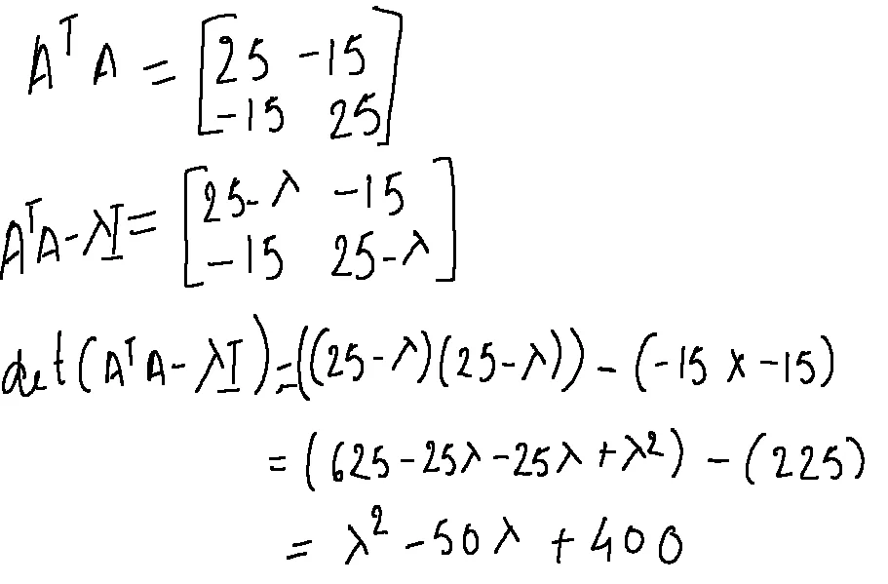
Step 2
Now, that we have a square matrix, we can calculate the eigenvalues of A(transpose) A. We, can do so by calculating the determinant of A(transpose)A — (lambda)I where lambda are the two eigenvalues.

Slide 61
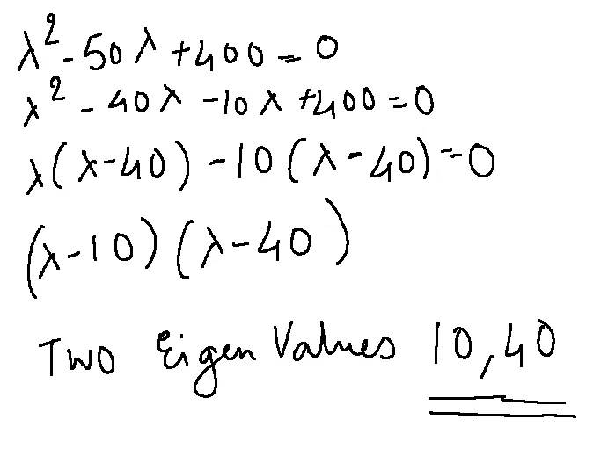

Slide 62
Step 3
Once we have calculated the eigenvalues, it’s time to calculate the two eigenvectors for each eigenvalue. So, let’s start by calculating the eigenvector for 10.
Step 3.1
We plug the value of lambda in the A(transpose)A — (lambda)I matrix.

Slide 63
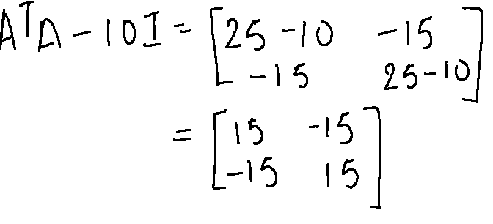
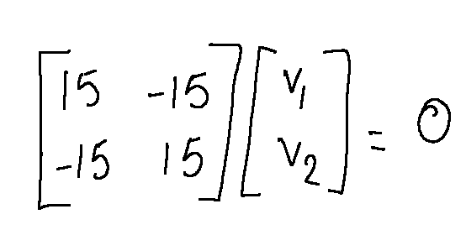
In order to find the eigenvector, we need to find the null space of a matrix where AB = 0. In other words,
Next, we need to reduce this matrix to the Row-Echelon Form so that we can easily solve the equation. Let’s talk about Row-Echelon for a moment here.

Slide 64
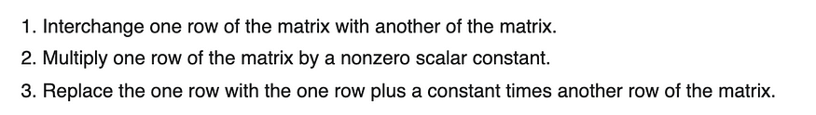
Row-Echelon Form
A matrix is said to be in row-echelon form if the following rules are satisfied.
All the leading entries in each row of the matrix is 1
If a column contains a leading entry then all the entries below the leading entry should be zero
If any two consecutive non-zero rows, the leading entry in the upper row should occur to the left of the leading entry in the lower row.
All rows which consist only of zeros should occur in the bottom of the matrix
We need to perform some operations on the rows to reduce the matrix. These operations are called elementary row operations and there are a certain rules to follow for these operations as given below,

Slide 65
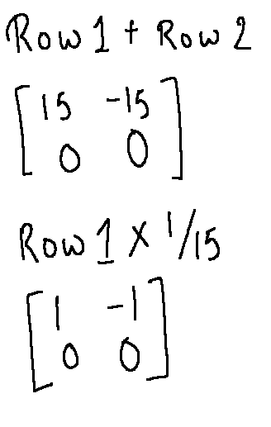
Armed with the above rules, lets start reducing the matrix in Step 3.1 to row-echelon form.
Now, we can solve for null space as below to find the eigenvector for eigenvalue 10

Slide 66
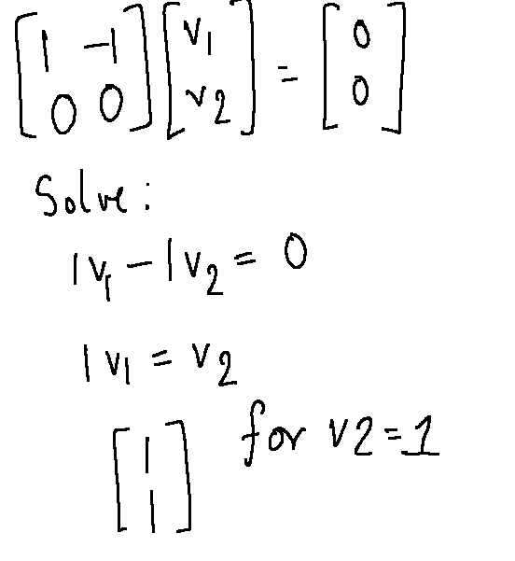

Slide 67
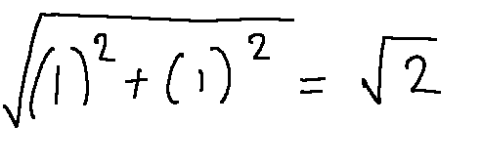
Once we get this vector, we need to convert it to a unit vector . The way we do that is by taking the columnar values and dividing them by taking the square root of the sum of squares of the values. So, in this case we do the following,

Slide 68
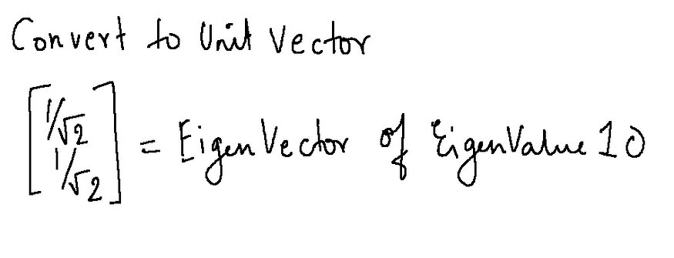
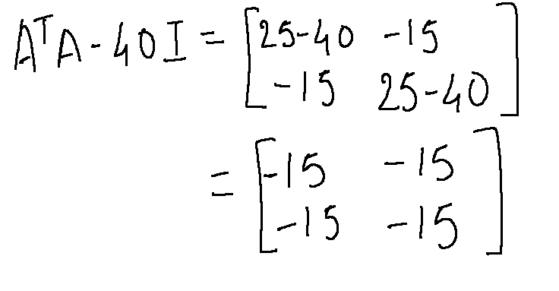
So the final eigenvector for eigenvalue is
We do the similar steps to get the eigenvector for eigenvalue 40

Slide 69
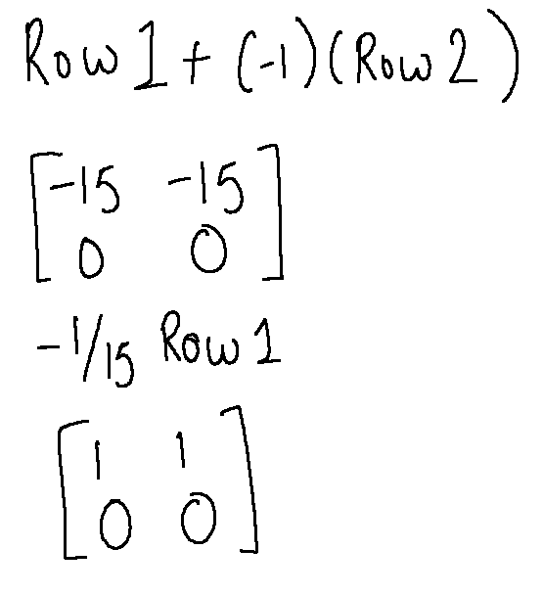
Matrix for computation

Slide 70

Row-Echelon Form
EigenVector for 40

Slide 71

Now that we have got both the eigenvectors, let’s put it together.

Slide 72
Note that the diagonal values in sigma are always in the descending order and so the vectors are also placed in that corresponding order. If you are familiar with PCA, the principal components correspond to the top k diagonal element which captures the most variance. The higher the value, the more important the component is and the more variance they describe.

Slide 73
Step 4
Now that we have our V and Sigma matrices, now it’s time to find U. We can just multiply the equation by sigma(inverse) and V on both sides to get the equation for U. In this case, as V is an orthogonal matrix, the transpose and inverse of V are the same, therefore, V(transpose) multiplied by V becomes an identity matrix. Same goes, for the diagonal matrix as well.
Note: On the left hand side, it is sigma(inverse) and not transpose as mentioned in the slide below

Slide 74

Computing A x V

Slide 75

Next up, we need to convert this to unit vectors using the steps described above.
AV as unit vectors

Slide 76

Next up we multiply this matrix with Sigma (transpose) which is sigma in itself because its a diagonal matrix.
AV x sigma (transpose)

Slide 77

U

Slide 78

So, there you go, we have calculated U, sigma and V and decomposed the matrix A into three matrices as given below.
SVD

Slide 79
Singular Value Decomposition and Matrix Factorization
Singular value decomposition: X=VAW^{T}
V is NxN and contains the eigenvectors of XX^{T}
W is dxd and contains the eigenvectors of X^{T}X
and A is Nxd and contains singular values on its first k diagonal
X=u₁a₁v₁^{T}+...+u_{k}a_{k}v_{k}^{T} where k is the rank of X

Slide 80

is that although the data may be too large, either it is sparse, or there is high correlation and it can be represented in a space of fewer dimensions.

Slide 81


Slide 82


Matrix Factorization
Matrix factorization: X=FG
F is Nxk and G is kxd
Latent semantic indexing

Slide 83
Multidimensional Scaling
Multidimensional scaling (MDS) is a dimensionality reduction technique that is used to project high-dimensional data onto a lower-dimensional space while preserving the pairwise distances between the data points as much as possible.
MDS is based on the concept of distance and aims to find a projection of the data that minimizes the differences between the distances in the original space and the distances in the lower-dimensional space.
MDS is commonly used to visualize complex, high-dimensional data, and to identify patterns and relationships that may not be apparent in the original space. It can be applied to a wide range of data types, including numerical, categorical, and mixed data.
MDS is implemented using numerical optimization algorithms, such as gradient descent or simulated annealing, to minimize the difference between the distances in the original and lower-dimensional spaces.

Slide 84
Features of the Multidimensional Scaling (MDS)
MDS is based on the concept of distance and aims to find a projection of the data that minimizes the differences between the distances in the original space and the distances in the lower-dimensional space. This allows MDS to preserve the relationships between the data points, and to highlight patterns and trends that may not be apparent in the original space.
MDS can be applied to a wide range of data types, including numerical, categorical, and mixed data. This makes MDS a versatile tool that can be used with many different kinds of data and allows it to handle complex multi-modal data sets.
MDS is implemented using numerical optimization algorithms, such as gradient descent or simulated annealing, to minimize the difference between the distances in the original and lower-dimensional spaces. This makes MDS a flexible and adaptable technique that can handle complex, nonlinear data, and can find projections that are different from those produced by linear techniques, such as principal component analysis (PCA).
MDS is widely used in many fields, including machine learning, data mining, and pattern recognition. This makes it a well-established and widely-supported technique that has been extensively tested and validated, and that has a large and active user community.

Slide 85
How Multidimensional Scaling (MDS) is compared to other dimensionality reduction technique techniques?
MDS is commonly compared to other dimensionality reduction techniques, such as principal component analysis (PCA) and t-distributed stochastic neighbor embedding (t-SNE), to understand how it differs from these techniques and when it may be more appropriate to use.
MDS is based on the concept of distance and aims to find a projection of the data that minimizes the differences between the distances in the original space and the distances in the lower-dimensional space. In contrast, PCA and t-SNE are based on the concept of variance and entropy, respectively, and aim to find a projection of the data that maximizes the variance or entropy in the lower-dimensional space. This means that MDS is more focused on preserving the relationships between the data points, while PCA and t-SNE are more focused on summarizing the data and finding the most relevant dimensions.
MDS can be applied to a wide range of data types, including numerical, categorical, and mixed data. In contrast, PCA and t-SNE are more suited to numerical data, and may not be as effective with categorical or mixed data. This makes MDS a more versatile and flexible technique and allows it to handle complex, multi-modal data sets.
MDS uses numerical optimization algorithms to find the projection that minimizes the stress function, and that best preserves the pairwise distances between the data points. In contrast, PCA and t-SNE use linear algebra and stochastic algorithms, respectively, to find the projection that maximizes the variance or entropy in the lower-dimensional space. This means that MDS is a more flexible and adaptable technique, and can find projections that are different from those produced by PCA or t-SNE.

Slide 86
Multidimensional Scaling
Let us say for N points, we are given the distances between pairs of points, dij , for all i,j = 1,...,N. We do not know the exact coordinates of the points, their dimensionality, or how the distances are calculated.
Multidimensional scaling (MDS) is the method for placing these points in scaling a low—for example, two-dimensional—space such that the Euclidean distance between them there is as close as possible to dij , the given distances in the original space. Thus it requires a projection from some unknown dimensional space to, for example, two dimensions.
MDS can be used for dimensionality reduction by calculating pairwise Euclidean distances in the d-dimensional x space and giving this as input to MDS, which then projects it to a lower-dimensional space so as to preserve these distances.

Slide 87

MDS can be used for dimensionality reduction by calculating pairwise Euclidean distances in the d-dimensional x space and giving this as input to MDS, which then projects it to a lower-dimensional space so as to preserve these distances.

Slide 88
We know from the spectral decomposition that X = CD^{1/2} can be used as an approximation for X, where C is the matrix whose columns are the eigenvectors of B and D^{1/2} is a diagonal matrix with square roots of the eigenvalues on the diagonals. Looking at the eigenvalues of B, we decide on a dimensionality k lower than d (and N), as we did in PCA and FA. Let us say cj are the eigenvectors with λj as the corresponding eigenvalues. Note that cj is N-dimensional. Then we get the new dimensions as

Slide 89

but in a general case, a nonlinear mapping can also be used; this is called Sammon mapping. The normalized error in mapping is called the Sam-mon stress and is defined as

Slide 90


Slide 91


Slide 92











Map of Europe by MDS
Map from CIA – The World Factbook: http://www.cia.gov/

Slide 93
Linear Discriminant Analysis
Linear Discriminant Analysis (LDA) is a supervised learning algorithm used for classification tasks in machine learning. It is a technique used to find a linear combination of features that best separates the classes in a dataset.
LDA works by projecting the data onto a lower-dimensional space that maximizes the separation between the classes. It does this by finding a set of linear discriminants that maximize the ratio of between-class variance to within-class variance. In other words, it finds the directions in the feature space that best separate the different classes of data.
LDA assumes that the data has a Gaussian distribution and that the covariance matrices of the different classes are equal. It also assumes that the data is linearly separable, meaning that a linear decision boundary can accurately classify the different classes.

Slide 94
Aadvantages, including:
It is a simple and computationally efficient algorithm.
It can work well even when the number of features is much larger than the number of training samples.
It can handle multicollinearity (correlation between features) in the data.

Slide 95

It is used for modelling differences in groups i.e. separating two or more classes.
It is used to project the features in higher dimension space into a lower dimension space. For example, we have two classes and we need to separate them efficiently. Classes can have multiple features. Using only a single feature to classify them may result in some overlapping as shown in the below figure. So, we will keep on increasing the number of features for proper classification.

Slide 96

Example: Suppose we have two sets of data points belonging to two different classes that we want to classify. As shown in the given 2D graph, when the data points are plotted on the 2D plane, there’s no straight line that can separate the two classes of the data points completely. Hence, in this case, LDA (Linear Discriminant Analysis) is used which reduces the 2D graph into a 1D graph in order to maximize the separability between the two classes.

Slide 97

Here, Linear Discriminant Analysis uses both the axes (X and Y) to create a new axis and projects data onto a new axis in a way to maximize the separation of the two categories and hence, reducing the 2D graph into a 1D graph.
Two criteria are used by LDA to create a new axis:
Maximize the distance between means of the two classes.
Minimize the variation within each class.

Slide 98

In the above graph, it can be seen that a new axis (in red) is generated and plotted in the 2D graph such that it maximizes the distance between the means of the two classes and minimizes the variation within each class. In simple terms, this newly generated axis increases the separation between the data points of the two classes. After generating this new axis using the above-mentioned criteria, all the data points of the classes are plotted on this new axis and are shown in the figure given below. But Linear Discriminant Analysis fails when the mean of the distributions are shared, as it becomes impossible for LDA to find a new axis that makes both the classes linearly separable. In such cases, we use non-linear discriminant analysis.

Slide 99


Slide 100



Slide 101
Difference between Linear Discriminant Analysis and PCA
Below are some basic differences between LDA and PCA:
PCA is an unsupervised algorithm that does not care about classes and labels and only aims to find the principal components to maximize the variance in the given dataset. At the same time, LDA is a supervised algorithm that aims to find the linear discriminants to represent the axes that maximize separation between different classes of data.
LDA is much more suitable for multi-class classification tasks compared to PCA. However, PCA is assumed to be an as good performer for a comparatively small sample size.
Both LDA and PCA are used as dimensionality reduction techniques, where PCA is first followed by LDA.

Slide 102


Slide 103


Slide 104


Slide 105

Linear Discriminant Analysis
Find a low-dimensional space such that when x is projected, classes are well-separated.
Find w that maximizes

Slide 106
Between-class scatter:
Within-class scatter:

Slide 107
Fisher’s Linear Discriminant
Find w that max
LDA soln:
Parametric soln:

Slide 108
K>2 Classes
Within-class scatter:
Between-class scatter:
Find W that max
The largest eigenvectors of S_{W}⁻¹S_{B;} maximum rank of K-1

Slide 109


Slide 110


Slide 111


Slide 112


Slide 113


Slide 114


Slide 115


Slide 116


Slide 117


Slide 118


Slide 119


Slide 120


Slide 121

=

Slide 122


Slide 123


Slide 124


Slide 125


Slide 126


Slide 127


Slide 128


Slide 129


Slide 130


Slide 131


Slide 132


Slide 133

PCA vs LDA

Slide 134
PCA vs LDA: Key Differences Objective: PCA is an unsupervised technique that aims to maximize the variance of the data along the principal components. The goal is to identify the directions that capture the most variation in the data. LDA, on the other hand, is a supervised technique that aims to maximize the separation between different classes in the data. The goal is to identify the directions that capture the most separation between the classes. Supervision: PCA does not require any knowledge of the class labels of the data, while LDA requires labeled data in order to learn the separation between the classes. Dimensionality Reduction: PCA reduces the dimensionality of the data by projecting it onto a lower-dimensional space, while LDA reduces the dimensionality of the data by creating a linear combination of the features that maximizes the separation between the classes. Output: PCA outputs principal components, which are linear combinations of the original features. These principal components are orthogonal to each other and capture the most variation in the data. LDA outputs discriminant functions, which are linear combinations of the original features that maximize the separation between the classes. Interpretation: PCA is often used for exploratory data analysis, as the principal components can be used to visualize the data and identify patterns. LDA is often used for classification tasks, as the discriminant functions can be used to separate the classes. Performance: PCA is generally faster and more computationally efficient than LDA, as it does not require labeled data. However, LDA may be more effective at capturing the most important information in the data when class labels are available.

Slide 135
Canonical Correlation Analysis
Canonical Correlation Analysis (CCA) is a statistical method used in data analysis to identify and quantify the relationships between two sets of variables. When working with multivariate data—that is, when there are several variables in each of the two sets and we want to know how they connect—it is very helpful.
A statistical method for examining and measuring correlations between two sets of variables is called Canonical Correlation Analysis (CCA). Fundamentally, CCA looks for linear combinations of variables—also referred to as canonical variables—within each set so that the correlation between them is maximized. Finding relationships and patterns of linkage between the two groups is the main objective.

Slide 136
Let’s take a practical example where we have two datasets, X and Y, each with many variables. By using canonical variates to describe the linear combinations of variables in X and Y, CCA maximizes the correlation between the canonical variates. The two datasets’ covariation patterns are represented by these canonical variates. These relationships’ strength is measured by the canonical correlations.
When working with high-dimensional datasets where comprehending the intricate correlations between variables is necessary, CCA is especially helpful.
Applications in genetics, psychology, economics, and other fields are among its many. For example, CCA in psychology can show correlations between behavioral variables and psychological exams.

Slide 137
CCA can detect associated gene expressions in genomics under various experimental setups. CCA helps researchers find significant insights and make wise judgments across a range of fields by offering a thorough perspective of relationships between sets of variables. This enables a deeper understanding of the underlying patterns and linkages in multidimensional data.
Primary Terminologies of Canonical Correlation Analysis (CCA)
Before we dive into the implementation of CCA, let’s define some primary terminologies:
Canonical Variables: These are the linear combinations of the original variables in each dataset that maximize the correlation between the two sets. Canonical variables are what CCA aims to find.
Canonical Correlations: These are the correlation coefficients between the canonical variables in the two datasets. The goal of CCA is to maximize these correlations.
Canonical Loadings: The coefficients known as canonical loadings specify the linear combinations of the original variables that were utilized to produce the canonical variables.
Canonical Variates: These are the canonical variables themselves.
Cross-Loadings: The association between variables from one dataset and the canonical variables from the other dataset is displayed using cross-loadings.

Slide 138


Slide 139


Slide 140


Slide 141


Slide 142

Canonical Correlation Analysis
X={x^{t},y^{t}}_{t} ; two sets of variables x and y x
We want to find two projections w and v st when x is projected along w and y is projected along v, the correlation is maximized:

Slide 143

CCA
x and y may be two different views or modalities; e.g., image and word tags, and CCA does a joint mapping
Figure 6.13 Canonical correlation analysis uses two sets of variables x and y and projects each so that the correlation after projections is maximized.

Slide 144

Isomap
Geodesic distance is the distance along the manifold that the data lies in, as opposed to the Euclidean distance in the input space

Slide 145
Isomap
A nonlinear dimensionality reduction method used in data analysis and machine learning is called isomap, short for isometric mapping. Isomap was developed to maintain the inherent geometry of high-dimensional data as a substitute for conventional techniques like Principal Component Analysis (PCA). Isomap creates a low-dimensional representation, usually a two- or three-dimensional map, by focusing on the preservation of pairwise distances between data points.
This technique works especially well for extracting the underlying structure from large, complex datasets, like those from speech recognition, image analysis, and biological systems. Finding patterns and insights in a variety of scientific and engineering domains is made possible by Isomap’s capacity to highlight the fundamental relationships found in data.

Slide 146
An understanding and representation of complicated data structures are crucial for the field of machine learning.
To achieve this, Manifold Learning, a subset of unsupervised learning, has a significant role to play. Among the manifold learning techniques, ISOMAP (Isometric Mapping) stands out for its prowess in capturing the intrinsic geometry of high-dimensional data. In the case of situations in which linear methods are lacking, they have proved particularly efficient.
ISOMAP is a flexible tool that seamlessly blends multiple learning and dimensionality reduction intending to obtain more detailed knowledge of the underlying structure of data. This article takes a look at ISOMAP’s inner workings and sheds light on its parameters, functions, and proper implementation with SkLearn.

Slide 147


Slide 148


Slide 149
Isomap
Instances r and s are connected in the graph if
||x^{r}-x^{s}||<ε or if x^{s} is one of the k neighbors of x^{r}
The edge length is ||x^{r}-x^{s}||
For two nodes r and s not connected, the distance is equal to the shortest path between them
Once the NxN distance matrix is thus formed, use MDS to find a lower-dimensional mapping

Slide 150
Manifold Learning
To understand the underlying structure of complex data, Manifold Learning is an unsupervised method of learning. Basically, it is aimed at capturing the inherent characteristics of High Definition Datasets and representing them from a less dimensional space. Multiple learning allows the discovery of nonlinear relationships hidden within data, which is a valuable asset in different applications compared to linear technique
Isometric Mapping Concept
The idea of an Isometric Map, which aims to preserve pairwise distance between points, is central to ISOMAP. In doing so, it seeks to achieve low dimensionality representation for the data while at the same time keeping geodesic distances as shortest possible along the curving edge of the data manifold. This is particularly important in situations where the underlying structure has been broken or folded, since traditional methods such as PCA are not able to take these nuances into account.
es.

Slide 151
Relation between Geodesic Distances and Euclidean Distances
Understanding the distinction between equatorial and elliptic distances is of vital importance for ISOMAP. The geodesic distance considers the shortest path along the curved surface of the manifold, as opposed to Euclidean distances which are measured by measuring straight Line distances in the input space. In order to provide a more precise representation of the data’s internal structure, ISOMAP exploits these quantum distances.

Slide 152
ISOMAP Parameters
ISOMAP comes with several parameters, each influencing the dimensionality reduction process:
n_neighbors: Determines the number of neighbors used to approximate geodesic distances. Higher values may make it possible to achieve higher results, but they still require more computing power.
n_components: Determines the number of dimensions in a low dimensional representation.
eigen_solver: Determines the method used for decomposing an Eigenvalue. There are options such as “auto”, “arpack” and “dense.”
radius: You can designate a radius within which neighbors are taken into account in place of using a set number of neighbors. Outside of this range, data points are not regarded as neighbors.
tol: tolerance in the eigenvalue solver to attain convergence. While a lower value might result in a more accurate solution, it might also lengthen the computation time.
max_iter: The maximum number of times the eigenvalue solver can run. It continues if None is selected, unless convergence or additional stopping conditions are satisfied.
path_method: chooses the approximation technique for geodesic distances on the graph. ‘auto’ (automatic selection) and ‘FW’ (Floyd-Warshall algorithm) are available options.
neighbors_algorithm: A method for calculating the closest neighbors. ‘Auto’, ‘ball_tree’, ‘kd_tree’, and ‘brute’ are among the available options. ‘auto’ selects the best algorithm according to the input data.
metric: The nearest neighbor search’s distance metric. ‘Minkowski‘ is the default; however, ‘euclidean’,’manhattan’, and several other options are also available.

Slide 153
Working of ISOMAP
Calculate the pairwise distances: The algorithm starts by calculating the Euclidean distances between the data points.
Find nearest neighbors according to these distances: For each data point, its k nearest neighbor is determined by that distance.
Create a neighborhood plot: the edges of each point are aligned with their closest neighbors, which creates a diagram that represents the data’s regional structure.
Calculate geodesic distances: The Floyd algorithm sorts through all the pairs of data points in a neighborhood graph and finds the most distant paths. geodesic distances are represented by these shortest paths.
Perform dimensional reduction: Classical Multi Scaling MDS is used for geodesic distance matrices that result in low dimensional embedding of data.

Slide 154
Matlab source from http://web.mit.edu/cocosci/isomap/isomap.html

Slide 155
Locally Linear Embedding
LLE(Locally Linear Embedding) is an unsupervised approach designed to transform data from its original high-dimensional space into a lower-dimensional representation, all while striving to retain the essential geometric characteristics of the underlying non-linear feature structure. LLE operates in several key steps:
Firstly, it constructs a nearest neighbors graph to capture these local relationships. Then, it optimizes weight values for each data point, aiming to minimize the reconstruction error when expressing a point as a linear combination of its neighbors. This weight matrix reflects the strength of connections between points.
Next, LLE computes a lower dimensional representation of the data by finding eigenvectors of a matrix derived from the weight matrix. These eigenvectors represent the most relevant directions in the reduced space. Users can specify the desired dimensionality for the output space, and LLE selects the top eigenvectors accordingly.

Slide 156
Mathematical Implementation of LLE Algorithm
The key idea of LLE is that locally, in the vicinity of each data point, the data lies approximately on a linear subspace. LLE attempts to unfold or unroll the data while preserving these local linear relationships.
Here is a mathematical overview of the LLE algorithm:

Slide 157

Where:
x_{i} represents the i-th data point.
w_{ij} are the weights that minimize the reconstruction error for data point x_{i} using its neighbors.
It aims to find a lower-dimensional representation of data while preserving local relationships.
The mathematical expression for LLE involves minimizing the reconstruction error of each data point by expressing it as a weighted sum of its k nearest neighbors‘ contributions.
This optimization is subject to constraints ensuring that the weights sum to 1 for each data point. Locally Linear Embedding (LLE) is a dimensionality reduction technique used in machine learning and data analysis.
It focuses on preserving local relationships between data points when mapping high-dimensional data to a lower-dimensional space. Here, we will explain the LLE algorithm and its parameters.

Slide 158
Locally Linear Embedding Algorithm
The LLE algorithm can be broken down into several steps:
Neighborhood Selection: For each data point in the high-dimensional space, LLE identifies its k-nearest neighbors. This step is crucial because LLE assumes that each data point can be well approximated by a linear combination of its neighbors.
Weight Matrix Construction: LLE computes a set of weights for each data point to express it as a linear combination of its neighbors. These weights are determined in such a way that the reconstruction error is minimized. Linear regression is often used to find these weights.
Global Structure Preservation: After constructing the weight matrix, LLE aims to find a lower-dimensional representation of the data that best preserves the local linear relationships. It does this by seeking a set of coordinates in the lower-dimensional space for each data point that minimizes a cost function. This cost function evaluates how well each data point can be represented by its neighbors.
Output Embedding: Once the optimization process is complete, LLE provides the final lower-dimensional representation of the data. This representation captures the essential structure of the data while reducing its dimensionality.

Slide 159
Parameters in LLE Algorithm
LLE has a few parameters that influence its behavior:
k (Number of Neighbors): This parameter determines how many nearest neighbors are considered when constructing the weight matrix. A larger k captures more global relationships but may introduce noise. A smaller k focuses on local relationships but can be sensitive to outliers. Selecting an appropriate value for k is essential for the algorithm’s success.
Dimensionality of Output Space: You can specify the dimensionality of the lower-dimensional space to which the data will be mapped. This is often chosen based on the problem’s requirements and the trade-off between computational complexity and information preservation.
Distance Metric: LLE relies on a distance metric to define the proximity between data points. Common choices include Euclidean distance, Manhattan distance, or custom-defined distance functions. The choice of distance metric can impact the results.
Regularization (Optional): In some cases, regularization terms are added to the cost function to prevent overfitting. Regularization can be useful when dealing with noisy data or when the number of neighbors is high.
Optimization Algorithm (Optional): LLE often uses optimization techniques like Singular Value Decomposition (SVD) or eigenvector methods to find the lower-dimensional representation. These optimization methods may have their own parameters that can be adjusted.
LLE (Locally Linear Embedding) represents a significant advancement in structural analysis, surpassing traditional density modeling techniques like local PCA or mixtures of factor analyzers. The limitation of density models lies in their inability to consistently establish a set of global coordinates capable of embedding observations across the entire structural manifold. Consequently, they prove inadequate for tasks such as generating low-dimensional projections of the original dataset. These models excel only in identifying linear features, as depicted in the image below. However, they fall short in capturing intricate curved patterns, a capability inherent to LLE.

Slide 160
Advantages of LLE
The dimensionality reduction method known as locally linear embedding (LLE) has many benefits for data processing and visualization. The following are LLE’s main benefits:
Preservation of Local Structures: LLE is excellent at maintaining the in-data local relationships or structures. It successfully captures the inherent geometry of nonlinear manifolds by maintaining pairwise distances between nearby data points.
Handling Non-Linearity: LLE has the ability to capture nonlinear patterns and structures in the data, in contrast to linear techniques like Principal Component Analysis (PCA). When working with complicated, curved, or twisted datasets, it is especially helpful.
Dimensionality Reduction: LLE lowers the dimensionality of the data while preserving its fundamental properties. Particularly when working with high-dimensional datasets, this reduction makes data presentation, exploration, and analysis simpler.
Disavantages of LLE
Curse of Dimensionality: LLE can experience the “curse of dimensionality” when used with extremely high-dimensional data, just like many other dimensionality reduction approaches. The number of neighbors required to capture local interactions rises as dimensionality does, potentially increasing the computational cost of the approach.
Memory and computational Requirements: For big datasets, creating a weighted adjacency matrix as part of LLE might be memory-intensive. The eigenvalue decomposition stage can also be computationally taxing for big datasets.
Outliers and Noisy data: LLE is susceptible to anomalies and jittery data points. The quality of the embedding may be affected and the local linear relationships may be distorted by outliers.

Slide 161
Locally Linear Embedding
Given x^{r} find its neighbors x^{s}_{(r)}
Find W_{rs} that minimize
Find the new coordinates z^{r} that minimize

Slide 162


Slide 163
LLE on Optdigits
Matlab source from http://www.cs.toronto.edu/~roweis/lle/code.html

Slide 164


Laplacian Eigenmaps
Let r and s be two instances and B_{rs} is their similarity, we want to find z^{r} and z^{s} that
B_{rs} can be defined in terms of similarity in an original space: 0 if x^{r} and x^{s} are too far, otherwise
Defines a graph Laplacian, and feature embedding returns z^{r}

Slide 165

Laplacian Eigenmaps

Slide 166


Slide 167

Laplacian Eigenmaps on Iris
Spectral clustering (chapter 7)

